Slide 1
ADDRESSING MODES AND FORMATS
Computer Organization and Assembly Language
Computer Science Department
National University of Computer and Emerging Sciences Islamabad

Slide 2
ADDRESSING MODES
Immediate
Direct
Indirect
Register
Register Indirect
Displacement (Indexed)
Stack
Notes:
2

Slide 3
IMMEDIATE ADDRESSING
Operand is part of instruction
Operand = address field
e.g. ADD 5
  Add 5 to contents of accumulator
  5 is operand
No memory reference to fetch data
Fast
Limited range
Notes:
3

Slide 4
IMMEDIATE ADDRESSING DIAGRAM
Instruction
Opcode
Operand
Notes:
4

Slide 5
DIRECT ADDRESSING
Address field contains address of operand
Effective address (EA) = address field (A)
e.g. ADD A
  Add contents of cell A to accumulator
  Look in memory at address A for operand
Single memory reference to access data
No additional calculations to work out effective address
Limited address space
Notes:
5

Slide 6
DIRECT ADDRESSING DIAGRAM
Instruction
Opcode
Address A
Memory
Operand
Notes:
6

Slide 7
INDIRECT ADDRESSING (1)
Memory cell pointed to by address field contains the address of (pointer to) the operand
EA = (A)
  Look in A, find address (A) and look there for operand
e.g. ADD (A)
  Add contents of cell pointed to by contents of A to accumulator
Notes:
7

Slide 8
INDIRECT ADDRESSING (2)
Large address space
2^{n} where n = word length
May be nested, multilevel, cascaded
  e.g. EA = (((A)))
      EA=(…..(A)….)
    Draw the diagram yourself
Multiple memory accesses to find operand
Hence slower
Notes:
8

Slide 9
INDIRECT ADDRESSING DIAGRAM
Instruction
Opcode
Address A
Memory
Pointer to operand
Operand
Notes:
9

Slide 10
REGISTER ADDRESSING (1)
Operand is held in register named in address filed
EA = R
Limited number of registers
Very small address field needed
  Shorter instructions
  Faster instruction fetch
Notes:
10

Slide 11
REGISTER ADDRESSING (2)
No memory access
Very fast execution
Very limited address space
Multiple registers helps performance
  Requires good assembly programming or compiler writing
c.f. Direct addressing
Notes:
11
Require good assembly programming. Why????

Slide 12
REGISTER ADDRESSING DIAGRAM
Instruction
Opcode
Register Address R
Registers
Operand
Notes:
12

Slide 13
REGISTER INDIRECT ADDRESSING
C.f. indirect addressing
EA = (R)
Operand is in memory cell pointed to by contents of register R
Large address space (2^{n})
One fewer memory access than indirect addressing
Notes:
13

Slide 14
REGISTER INDIRECT ADDRESSING DIAGRAM
Instruction
Opcode
Register Address R
Memory
Registers
Pointer to Operand
Operand
Notes:
14

Slide 15
DISPLACEMENT ADDRESSING
EA = A + (R)
Address field hold two values
  A = base value
  R = register that holds displacement
  or vice versa
Notes:
15

Slide 16
DISPLACEMENT ADDRESSING DIAGRAM
Instruction
Opcode
Register R
Address A
Memory
Registers
Pointer to Operand
Operand
+
Notes:
16

Slide 17
RELATIVE ADDRESSING
A version of displacement addressing
Also called PC-relative addressing
R = Program counter, PC
EA = A + (PC)
i.e. get operand from the cell which is A cells away from current location pointed to by PC
Address field is generally 2’s compliment
c.f locality of reference & cache usage
Notes:
17
Displacement related to the address of the instruction

Slide 18
BASE-REGISTER ADDRESSING
A holds displacement, usually unsigned integer
R holds pointer to base address
R may be explicit or implicit
  e.g. segment registers in 80x86
EA = A + (R)
Notes:
18
Programmer may choose a register to hold the base address of a segment
If length of address field=K
No of possible registers=N
1 instruction can refer any one of N areas of 2^{K} words

Slide 19
INDEXED ADDRESSING
Opposite of base-register addressing
A = base
R = displacement
EA = A + (R)
Good for accessing arrays in loops
  EA = A + (R)
  (R)++
Notes:
19
MOV DL, [EAX+EBX]

Slide 20
COMBINATIONS
Indexed and indirect in same instruction
Postindex
  EA = (A) + (R)
  Indexing is performed after indirection
Preindex
  EA = (A + (R))
  Indexing is performed before indirection
Notes:
20
Preindex:
Simple indexing
Calculated address contains not the operand but the address of the operand

Slide 21
STACK ADDRESSING
Operand is (implicitly) on top of stack
e.g.
  ADD Pop top two items from stack and add
Stack pointer has the address to the top of the stack
Can be assumed as register indirect addressing
Notes:
21

Slide 22
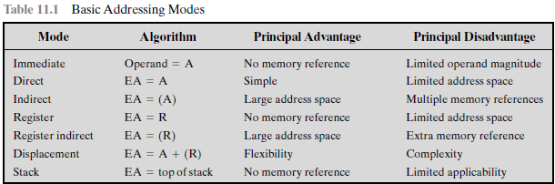
SUMMARY

Slide 23
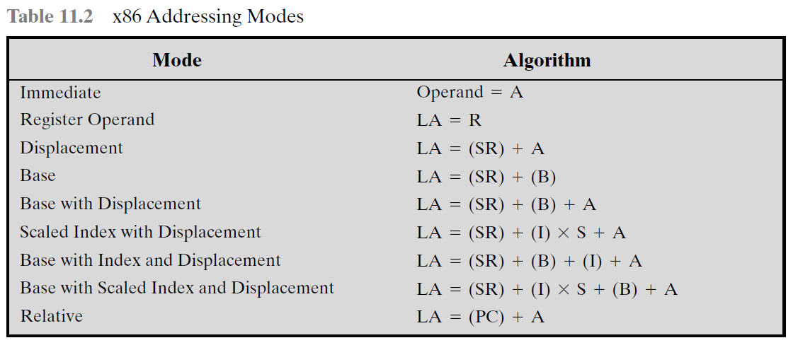
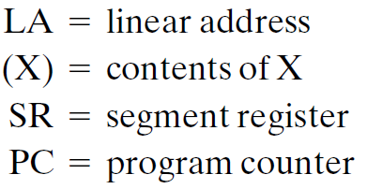
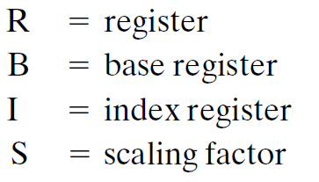
X86 ADDRESSING MODES

Slide 24
FOREGROUND READING
William Stallings
Chapter 11, 8th Edition
Chapter 13, 9th Edition
Intel and PowerPC Web sites

